Slide 1
CV PROJECT
Team ID: 15
Team Members:
Sai Jashwanth (20171178), Sai Soorya Rao (20171052), Raviteja (20171067)
TA Mentor : Pranay Gupta
Project ID, TITLE : 19, View Adaptive Neural Networks for High Performance Skeleton-based Human Action Recognition

Slide 2
ABSTRACT
One of the key challenges in action recognition lies in the large variations of action representations when they are captured from different viewpoints. This paper introduces a novel view adaptation scheme, which automatically determines the virtual observation viewpoints over the course of an action in a learning based data driven manner.
They designed two view adaptive neural networks, i.e., VA-RNN and VA-CNN. For each network, a novel view adaptation module learns and determines the most suitable observation viewpoints, and transforms the skeletons to those viewpoints for the end-to-end recognition with a main classification network.

Slide 3
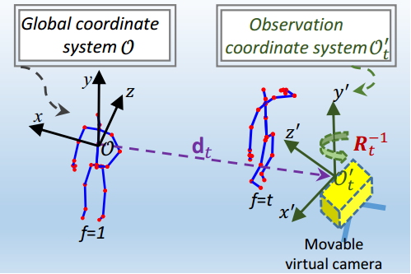

PROBLEM FORMULATION
Given a skeleton sequence S under the global coordinate system O, the jth skeleton joint on the t’th frame is
denoted as T denotes the total number of frames
a sequence, J denotes the total number of skeleton joints in a frame. The set of joints in
the t’th frame is denoted as .
The skeleton representation, under new
observation coordinate.

Slide 4
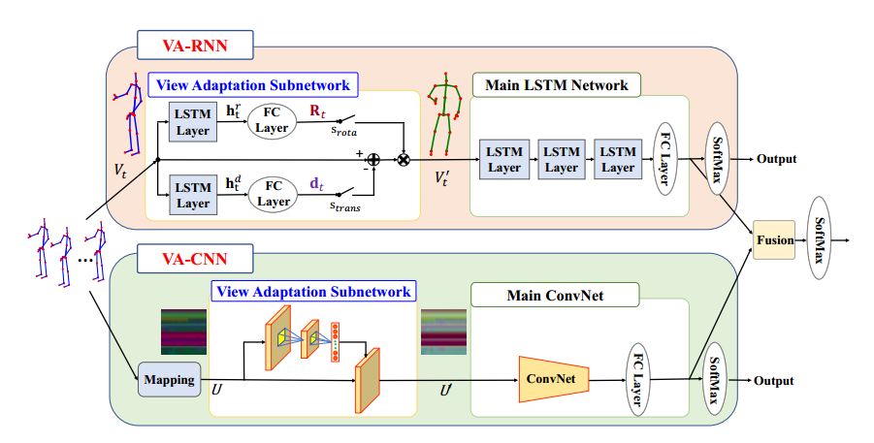
WORKFLOW

Slide 5

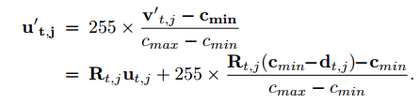
View Adaptive Convolution Neural Network (VA-CNN)
First we Map Skeletons to Image, with columns representing different frames while rows representing different joints. The 3D coordinate values for X, Y ,and Z are treated as the three channels of an image.
Next View Adaptation Subnetwork:
Main ConvNet: Transformed
skeleton map as input, we
Use RESNET with pretrained
weights, for classification.

Slide 6
NTU-Data Visualization
GIF Data Drinking created on our dataset using 30 frames

Slide 7
GOALS
Creating DataSet in addition to available dataset(NTU RGB-D) by performing view enriching by rotation of the skeleton around the axes during training procedure.
Implementing the VA-CNN for VA-Subnetwork.
Implementing the VA subnetwork first and then implementing the main classifier network.
Obtaining and comparing the results with that of paper.
Implementing VA-RNN for course project if time permits.

Slide 8
Data loading / Pre Processing from NTU Dataset
There are 1 or more subjects in each frame and each subject has 25 joints according to NTU Dataset.
We consider a maximum of 2 subjects.
Skeleton seq is mapped to image map to facilitate the process. Image map has 3 channels.
Columns in image map correspond to different frames.
Rows correspond to different joints
This is employed in collate_fn of DataLoader.

Slide 9
VA- CNN subnet
With this, we aim to learn 𝛂, 𝛃, 𝝲 (rotation parameters) and translation parameter for a sequence.
We build this subnet by stacking 2 conv. Layers and an FC layer. Activation layer is ReLu.
Each FC layer is followed by Batch Normalization Layer
Initial weights of FC are set to be zero.
Using these parameters, we transform the skeleton map corresponding to the new observation viewpoint.

Slide 10
ESTIMATED TIMELINE
WORK | DATE
MID EVALUATION | 11-03-2020
Creating view enriched data set | 17-03-2020
End-to-End Training on Dataset | 22-03-2020
Final Submission | 28-03-2020

Slide 11
Road Ahead...
Integrating VA Subnet with Main ConvNet
Enriching Dataset
End to End Training

